Slide 1

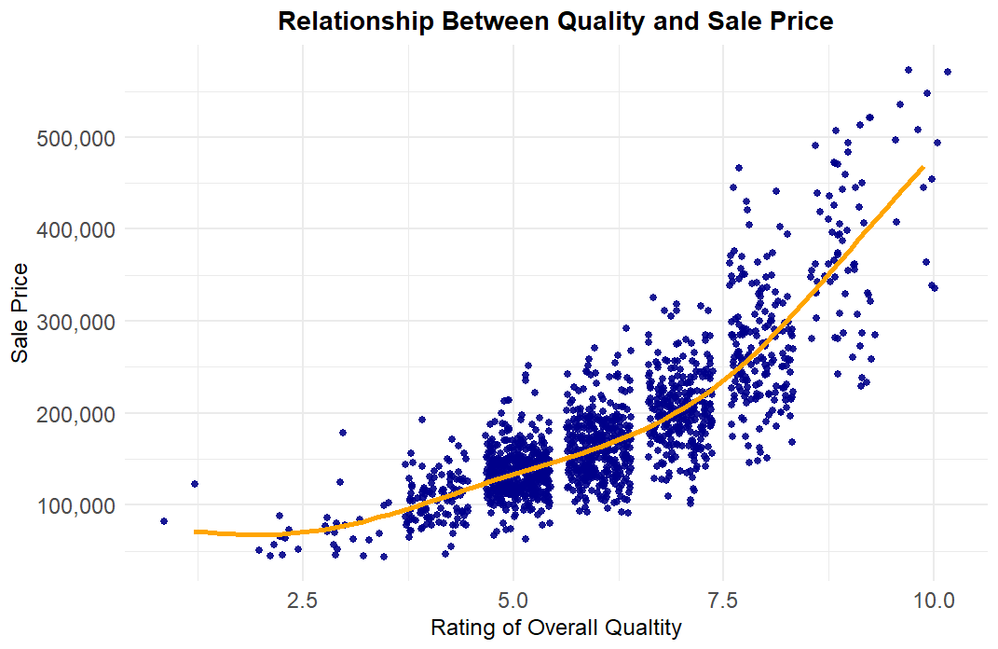
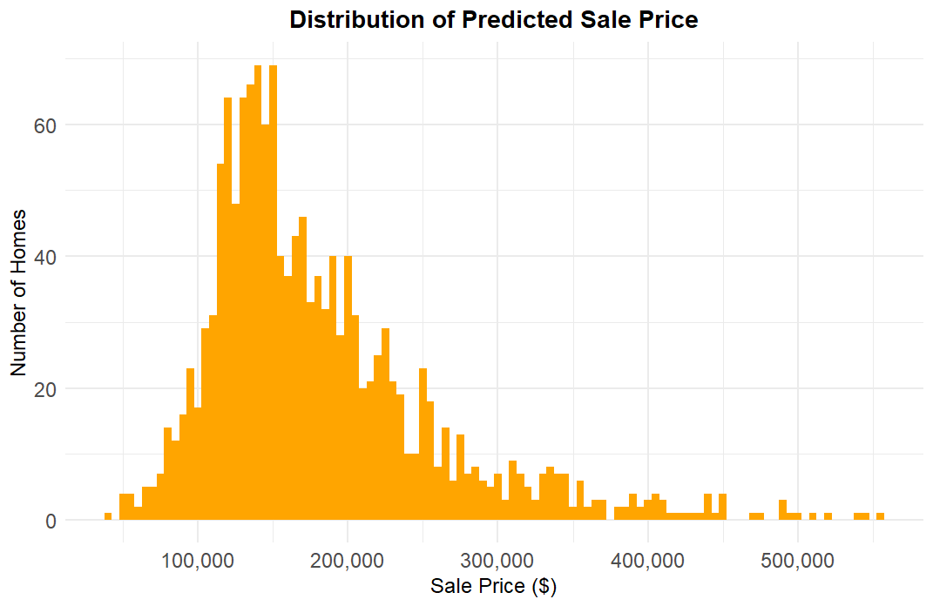
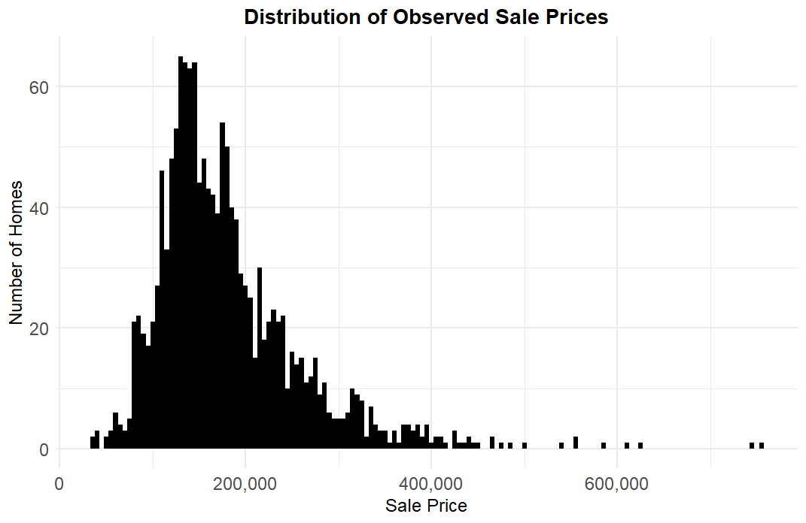
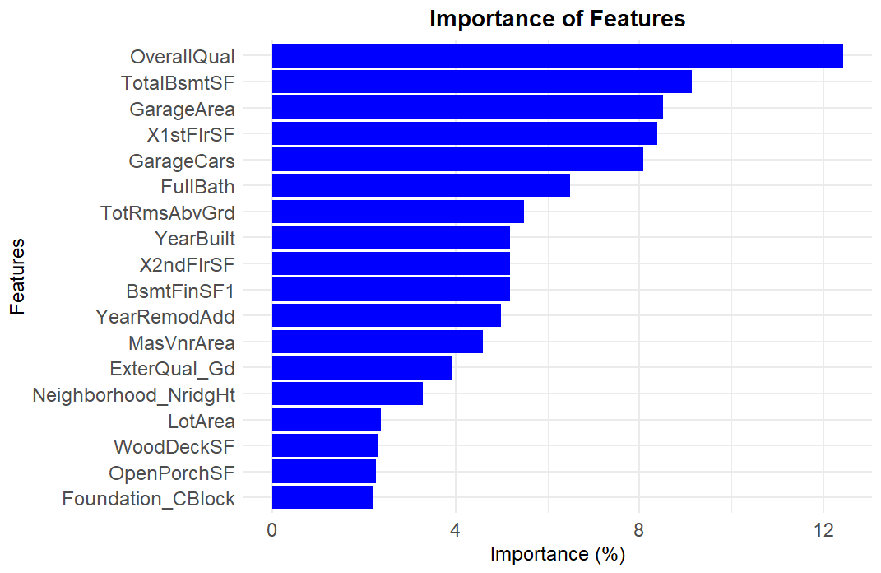
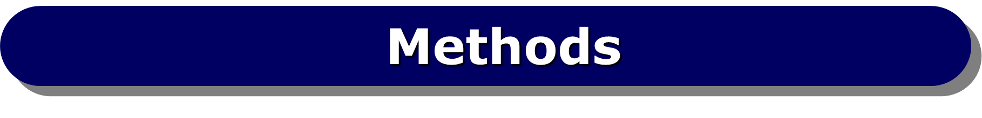
Predicting House Prices in Ames, Iowa: Analyzing the Impact of Certain Features on Real Estate Valuation
Kolby Porter
The University of Texas at San Antonio, San Antonio TX, 78249
Kolby.porter@my.utsa.edu
(830) 214-4355
Abstract
Methods – con’t
Results - con’t
Housing prices in Ames, Iowa were analyzed by reviewing the impact of different features commonly found among homes sold in Ames. By using 79 explanatory variables cataloged for 1460 homes, historic prices were analyzed and predicted for another 1459 homes. The explanatory variables ranged from overall quality of the property to the pool area in square feet. Of the original 79 features, most variables were factored and one-hot coded to create indicator variables that signaled a features existence. Of the new feature set, 42 variables were kept and used to predict new prices.
Data Transformation:
Data were centered and scaled to normalize the distribution of features for model training. Box-Cox was avoided for simplicity in predicting sale price. The model training data was split into training and testing sets (80-20 split).
Model Building:
Several models were tested, but ultimately an adaptive variable neural network was used to predict sale price of the test data provided.
Model Evaluation:
Each model was evaluated using cross-validated metrics such as MAE, RMSE and R squared. The neural net model outperformed the SVM model at a statistically significant level. The following chart compares their performance
Variable importance was measured, and the results was consistent across each model.
Predicted Sale Price of Test Data
Introduction
Ames, Iowa is a town of approximately 67,000 people as of 2020 and is best know for being the home of Iowa State University. The following analysis uses data from a study on homes sold in Ames from 2006 to 2010. The data from this study includes 79 characteristics about each home. Those characteristics range from yard size to number of bedrooms. Each observed characteristic describes an attribute that would theoretically affect each homes dollar value in some tangible way. The catalogued data used “NA” to denote the absence of a particular characteristic from a given observation. Those “NA”s were changed to zeros for the purpose of this analysis.
Of the 79 variables presented for this study, all of the categorical variables were broken out into binary indicators to perform this analysis. After trimming the predictors that appeared to hold little no impact toward the value of each home, we were left with 42 variables to use for our final model.
Some notable characteristics that were used in the final model include, basement square footage, number of cars that can be stored in the garage and the overall rating of material and finish of the house.
Model Performance
 | RMSE | R squared | MAE
SVM | 0.456638 | 0.808699 | 0.234192
PLS | 0.46874 | 0.783341 | 0.267846
NNet | 0.369291 | 0.872429 | 0.221703
MARS | 0.599984 | 0.695107 | 0.290827
The model above displays the relationship between the variable used to describe a home’s overall quality compared to the predicted sale price. Homes rated at 9 or above for overall quality are predicted to sell for as much as 1.87 times the average value of all of the homes rated anywhere below 9.
The model above presents visualization of the predicted sale prices of homes, utilizing the data obtained from our neural network model. The width of each bin represents $5,000; the bar’s height shows the number of homes within a specific price range. The distribution was heavily skewed to the right – as is to be expected. The mean home price predicted was $181,179. Observed sale prices from the training data set are shown below.
Conclusions
The sale price of homes in Ames Iowa is largely driven by space and quality of finish.
A few factors like gabled roofs and cinderblock foundation negatively impact sale price.
Homes that were recently built or remodeled fetch a higher selling price.
While some neighborhoods show a negative correlation on sale price, they are of little consequence compared to space and quality.
Future modeling may benefit from better preprocessing – increasing model prediction power. Box-Cox and Yeo Johnson preprocessing methods would be ideal but convert predictions into tangible results would be cumbersome.
Results
Observed Sale Prices
The results from our analysis yield some interesting findings. The most important variables used by our neural net model are graphically represented below.
Overall quality rating was found to be the most impactful on price, followed by basement square footage, and garage area. None of the variables shown above were negatively correlated to sale price.
Objective
Our goal is to identify the key characteristics that most significantly impact home prices and to validate these findings by predicting the prices of homes with similar attributes using the data from this study.
Data Preprocessing:
Missing values in both datasets were identified and imputed with zeros. Character variables were converted to factors, and one-hot encoding was applied to convert categorical variables into binary indicator variables. Near-zero variance predictors were removed to reduce dimensionality and avoid potential noise.
References
The observed sale prices were skewed farther to the right, with a max value of $755,000 compared to the predicted price max of $554,145. The mean value of the observed sale prices was $180,921.
Anna Montoya, DataCanary. (2016). House Prices - Advanced Regression Techniques. Kaggle.
https://kaggle.com/competitions/house-prices-advanced-regression-techniques

